Slide 1
WIRELESS LAN (802.11n)
Wireless local area network
Its is the commenly used WLAN
Published in October 2009

Slide 2
What is 802.11n wireless network?
802.11n is an update to IEEE 802.11g, which supported a maximum connection speed of 54 megabits per second (Mbps)
802.11n supports multi-channel utilization and dual band support for both 2.4 gigahertz (GHz) and 5 GHz frequencies with a maximum data rate of 600 Mbps.
802.11n will increase wireless local area network(WLAN) speed

Slide 3
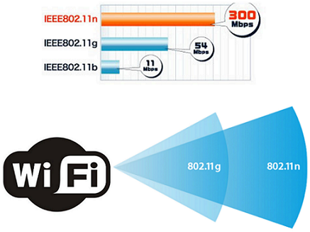
Types of IEEE 802.11

Slide 4
802.11n Advantages and Disadvantages
Advantage
Disadvantages
Improvement of significant bandwidth compared to previous standards
802.11n is totally backward compatible. It can support 802.11a, b and g standard
more updated latest version like
802.11ax in 2019
More expensive compared to previous standards

Slide 5

802.11n Dongle

